Slide 1
NA3 – The Network Layer
COMP 256 – Dickinson College
Prof. Braught
Spring 2023
Image from: https://dealna.com/Article/
Post/6564/Networking-Accessories

Slide 2
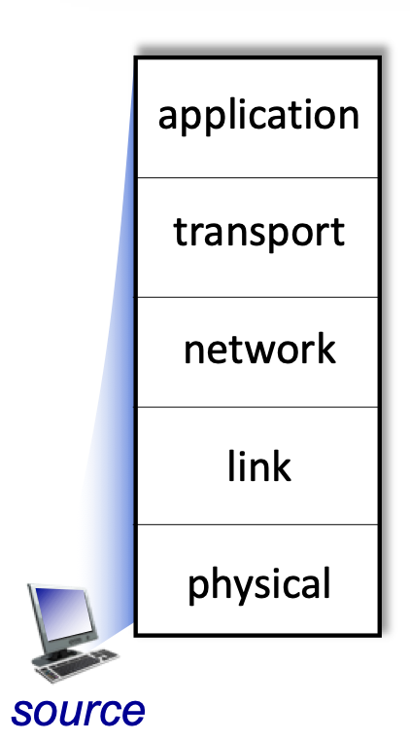
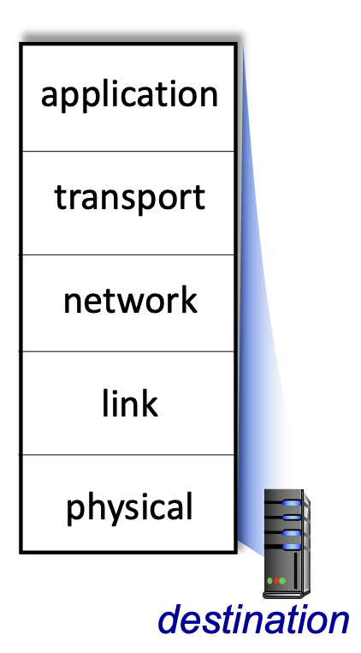
Bridging the Chasm: Network Layers
Getting information from one application to another.
Application Layer Service
HTTP
HTTP
TCP/
UDP
Transport Layer Services
TCP/
UDP
Source
Network Layer Services
Destination
IP
IP
Ether- net
Link Layer Services
Ether- net
Physical Layer Services
Wires
Wires
Image adapted from: http://gaia.cs.umass.edu/kurose_ross/videos/1/5/1.5_video_slides_posted.pptx

Slide 3
Network Data Encapsulation
Data
Data
Data
Data
Link Layer Info
Network Layer Info
Message
Transport Layer Info
Application
Layer Info

Slide 4
The Network Layer

Slide 5
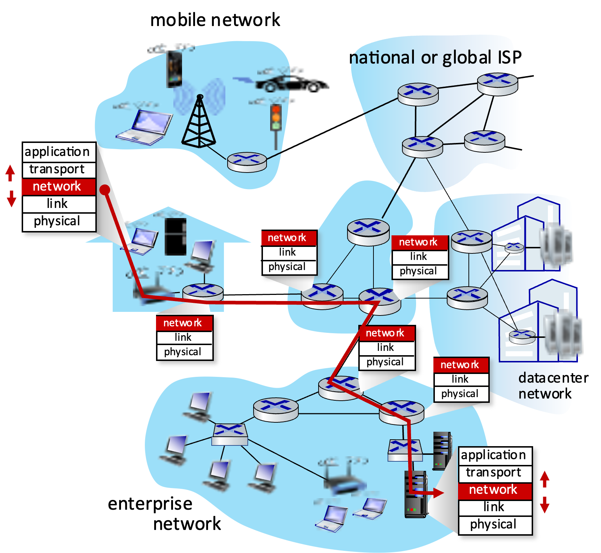
The Network Layer
Source
The network layer provides the service of routing messages from one end system (source) to another (destination).
Destination
Image adapted from: http://gaia.cs.umass.edu/kurose_ross/videos/4/1/4.1_video_slides.pptx
Notes:
Overall goal… understand how a message makes it from the source to the destination.
- Like the activity we did earlier.
- In that activity the routers picked the next hop by
- looking around to see which next router was closer to the destination.
- As we’ll see… that is not that terribly different than what happens in practice.
The network service uses the lower level services to provide its service.
- Data Link Layer
- Physical Layer

Slide 6
Routing
Routing is the process of finding a path for network packets from their source to their destination via a sequence of routers.
Centralized Routing:
The first router plans the entire route from source to destination.
Decentralized Routing:
Each router just determines the next hop such that the packet gets closer to its destination.
Internet Protocol (IP)
Notes:
Asking for driving directions is a good metaphor here:
Centralized Routing:
- This is like asking someone for directions and they know exactly where you are going.
- They can tell you a sequence of landmarks and turns that will get you from where you are (the source) to where you want to go (the destination).
- Today we call that person Google Maps.
Decentralized Routing:
- This is like asking someone for directions and they don’t quite know how to get where you are going.
- But they do know that from where you are you take a particular road to the next town.
- So they point you to that road and suggest you stop there at this one gas station and ask again
- You go there, pull in and ask again
- They direct you to the next road and another place to stop for directions.
- Each set of directions getting you closer
- But no one knows exactly how you get all the way there.
We will focus on Decentralized Routing using the Internet Protocol (IP)

Slide 7


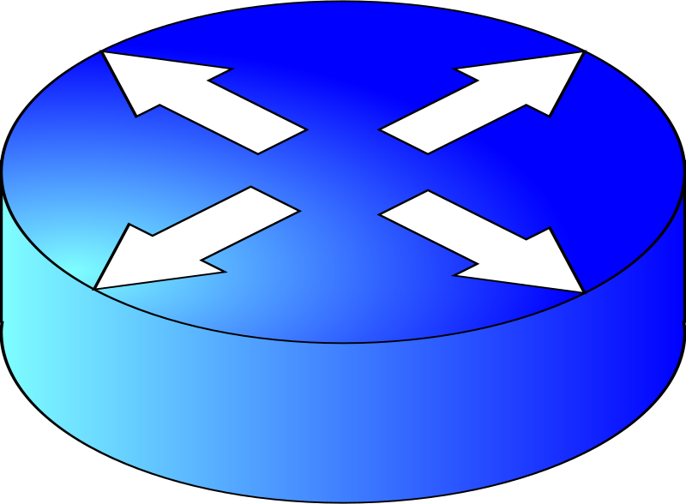
Decentralized Routing Activity
B.2
A.2
A.1
B.1
B.3
A.7
R1
R2
A
A.9
V.2
V.4
B.6
B
V
Z.1
X.2
Z
X
Z.9
X.7
D
D.4
C.2
C
Y
D.1
Y.4
Y.6
C.9
R4
R3
D.2
D.3
C.3
C.7
Notes:
Network Topology
- Assign four students near center of the room to be the routers.
- Give them a routing table and their assigned Addresses
- They are connected via subnets V, X, Y, Z as shown.
- As well as to their local networks A, B, C, D as shown.
- Note: Drawn this way just to keep the lines from crossing and getting messy.
- But these could be stretched and distorted and twisted however.
- Routers hand out LAN address addresses to 2 or 3 students around them (just not the other routers)
- E.g. A.1, A.2, A.7.

Slide 8
Decentralized Routing Activity
Routing Table R1
Routing Table R2
Router R1 Interfaces
Destination Network | Network Interface | Next Hop
A | W | -
B | E | V.4
C | E | V.4
D | S | Z.9
Router R2 Interfaces
Destination Network | Network Interface | Next Hop
A | W | V.2
B | E | -
C | S | X.7
D | S | X.7
Interface | Address
E | V.2
S | Z.1
W | A.9
Interface | Address
E | B.6
S | X.2
W | V.4
Routing Table R4
Routing Table R3
Router R4 Interfaces
Destination Network | Network Interface | Next Hop
A | N | Z.1
B | E | Y.6
C | N | Z.1
D | W | -
Router R3 Interfaces
Destination Network | Network Interface | Next Hop
A | W | Y.4
B | N | X.2
C | E | -
D | N | X.2
Interface | Address
N | Z.9
E | Y.4
W | D.4
Interface | Address
N | X.7
E | C.2
W | Y.6
Notes:
Print and Cut these to hand out to the routers.
The Network Interfaces are specified as N, S, E, W for North, South, East and West as per the compass.
- This is just easier than trying to have named interfaces for people to keep track of.
Note: From D to C goes long way around.
Note: From C to D has a loop (R3->R2->R3->R2->…)

Slide 9
Decentralized Routing Activity
End System A.1
End System B.1
End System C.3
End System D.1
Config | Value
Address | A.1
Router | A.9
Config | Value
Address | B.1
Router | B.6
Config | Value
Address | C.3
Router | C.2
Config | Value
Address | D.1
Router | D.4
End System A.2
End System B.2
End System C.7
End System D.2
Config | Value
Address | A.2
Router | A.9
Config | Value
Address | B.2
Router | B.6
Config | Value
Address | C.7
Router | C.2
Config | Value
Address | D.2
Router | D.4
End System A.7
End System B.3
End System C.9
End System D.3
Config | Value
Address | A.7
Router | A.9
Config | Value
Address | B.3
Router | B.6
Config | Value
Address | C.9
Router | C.2
Config | Value
Address | D.3
Router | D.4
Notes:
Print and cut these for routers to hand out to the machines.

Slide 10
Decentralized Routing Activity
Datagram 1
Datagram 4
SRC | DEST
A.2 | B.3
Hello! | D.4
SRC | DEST
D.2 | C.3
So long… | D.4
Datagram 2
Datagram 5
SRC | DEST
A.7 | C.7
How’s the weather? | D.4
SRC | DEST
C.9 | D.1
Forever?!?! | D.4
Datagram 3
Datagram 6
SRC | DEST
C.7
 | D.4
SRC | DEST
B.1 | B.2
Does this work? | D.4
Notes:
Print and cut these for routers to hand out to the machines.
Datagram … like telegram.
- Just the name used for messages in the Network Layer.
Datagram 3 should be a reply to Datagram 2.

Slide 11
Questions:
Does a node or router know the route a datagram will follow?
Do packets necessarily follow same path in both directions?
What would have to happen to change the route a datagram takes?
What would have generated the response with the weather?
Will a datagram always be delivered? Why or why not?
If a datagram is delivered, is it always done efficiently?
What could we do to detect cycles?
Notes:
Efficiency:
- Long routes
- What about within a LAN?

Slide 12
Internet Protocol

Slide 13
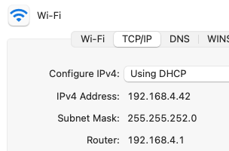
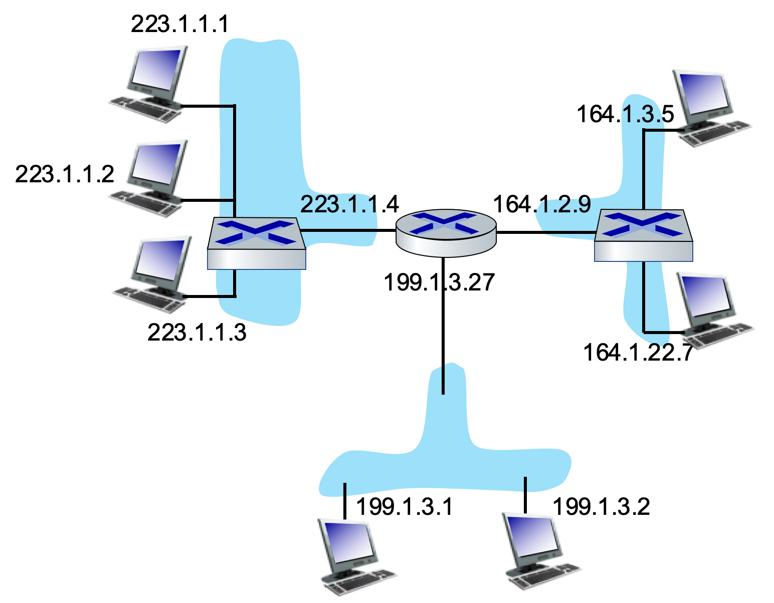
Internet Protocol (IP) Addresses
wifi
223.1.1.1
255.255.255.0
eth0
eth1
223.1.1.4
Every network interface on the Internet has an assigned IP Address
IP addresses are “dotted octets”*
223.1.1.7
1101 1111.0000 0001.0000 0001.000 00111
Each number represents 8 bits (an “octet”)
eth2
Image adapted from: http://gaia.cs.umass.edu/kurose_ross/videos/4/3/4.3_video_slides.pptx
Notes:
You’ve probably seen these numbers before on your machine in the settings.
- If not you can go look.
They used to be assigned manually by a network administrator.
Now they are typically assigned by an application level service named DHCP.
- DHCP is just a way for your computer to ask for an IP number when it connects to the network.
- Simplifies connecting to the network
- Essential with mobile devices that connect to many networks without needing a network administrator.
* Note: We are considering IP V4 in these examples. IP V6 is a newer protocol
- IP V6 in part addresses the need for many many more IP addresses than are available via IP V4.

Slide 14
Internet Protocol Subnets
wifi
223.1.1.1
eth0
eth1
255.255.255.0
223.1.1.4
Each local area network is a subnet.
Each subnet uses a defined range of IP addresses.
A subnet mask is used to find the subnet address from an IP address.
eth2
Image adapted from: http://gaia.cs.umass.edu/kurose_ross/videos/4/3/4.3_video_slides.pptx
Notes:
The subnet 233.1.1.0 can contain addresses
- That start with 233.1.1
- and then have any value in the 4th octet
- 223.1.1.1, 233.1.1.2, 233.1.2.198, etc…
The subnet 199.1.3 is similar.
What might the subnet ?.?.?.? be?
- Notice that the last two octets vary in this subnet.
The Subnet Mask is used to get the Subnet Information from an IP address.
- Performing a bitwise AND of an IP address with the Subnet Mask gives the Subnet Address:
- For example:
1101 1111.0000 0001.0000 0001.0000 0001 (231.1.1.1)
& 1111 1111.1111 1111.1111 1111.0000 0000 (255.255.255.0)
-------------------------------------------------------------
1101 1111.0000 0001.0000 0001.0000 0000 (231.1.1.0)
This allows a router to quickly determine the subnet to which the datagram should be routed.

Slide 15
Internet Protocol Routers
wifi
223.1.1.1
255.255.255.0
eth0
eth1
223.1.1.4
Routers direct packets between subnets.
Thus, they have multiple network interfaces and multiple IP addresses.
End system knows IP address of its default / first-hop / gateway router
eth2
Image adapted from: http://gaia.cs.umass.edu/kurose_ross/videos/4/3/4.3_video_slides.pptx
Notes:
The job of a router is to direct packets between subnets.
- For example, if machine 223.1.1.1 is sending data to machine 164.1.3.5
- Then the router here will:
- Receive that packet from subnet 223.1.1.0 to subnet 164.1.0.0
To do this the router must have multiple network interfaces
- Each network interface in the router is connected to a different subnet.
- Each interface has an IP address for the subnet to which it is attached.
- This allows the router to move packets from one subnet to another.
Note: Ethernet interfaces are often called eth0, eth1, eth2, etc for each Ethernet interface at a node.
Each end-system knows the IP address of its router.
- This is called the default, first-hop or gateway router.
- It is the router to which the system will send its outgoing packets.
What would router configuration be for
- the machine with IP address 164.1.3.5?
- the machine with IP address 199.1.3.2?

Slide 16
IP Message (datagram) Format
Important parts:
Length: The length of the data.
Header Checksum: Error detection information for the header information.
Source IP Address: IP address of end-system that sent the message.
Destination IP Address: IP address of end-system that is intended to receive the message.
Payload: The transport layer datagram that contains the application layer data.
Notes:
Of course, all of it is important…
- But at the level of depth that we are studying networking in this class, these are the essential parts.
Length: Like we saw with Ethernet frames the amount of data that is sent in a given message can vary.
- This indicates the length of the data part of the datagram in bytes.
- In practice, this is almost always between 64 and 1500 bytes… why?
Header Checksum: This is error detection information.
- Here, the error detection is applied just to the header information and not to the data.
- Error detection for the data is done at the transport layer and as we saw at the data link layer.
- So there some redundancy built into the system here.
Source and Destination addresses: These are the 32-bit representations of the “dotted octet” addresses of the sender and receiver.
Payload: The data being transmitted.
- This is what was handed to the network layer from the transport layer.
- The transport layer will have wrapped up what it was handed to it from the application layer.

Slide 17
IP is a ”Best Effort” Protocol
Timing between datagrams is not guaranteed to be preserved.
Datagrams are not guaranteed to be received in order.
Delivery of datagrams is not guaranteed.
Notes:
If there is a route and everything goes well, your datagrams will get there…
But…
- They are not guaranteed to arrive at the rate you sent them.
- You might send 10 per second,
- but they may arrive at 5 per second.
- Or none may arrive for a long time and then 50 in one second.
- So if timing matters, your application will need to deal with that.
- This is “buffering…”
- They are not guaranteed to be received in the order that they are sent.
- If you send 10 datagrams 1…10, they may be received in any order at the destination.
- So if the order matters, and it usually does you’ll need a higher layer protocol to handle this.
- Luckily the Transport layer provides a way…
- A datagram you sent is not guaranteed to be delivered at all, and you will not be notified.
- This goes back to the fact that the ethernet frames are unreliable.
- The IP datagrams are wrapped in an Ethernet frame to be sent
- If there is an error detected by the CRC value then the frame (and thus the datagram) is silently dropped.
So we still don’t have any way to ensure data gets where it is going.
- Though, to be fair…
- Most of the time it does!
Again… we’ll have to look at higher layer protocols to give us reliable service.

Slide 18
Internet Routing
Notes:
We got a little taste for how this works earlier.
Now, let’s dig into the details a little more.

Slide 19
An IP Routing Table*
Routing Table
Dest. Net Mask | IFace | Next Hop
223.1.1.0 | eth0 | -
164.1.0.0 | eth1 | -
199.1.3.0 | eth2 | -
eth0
eth1
eth2
Each router maintains a routing table.
The routing table answers the question… “If I get a datagram destined for subnet a.b.c.d, where do I send it?”
Image adapted from: http://gaia.cs.umass.edu/kurose_ross/videos/4/3/4.3_video_slides.pptx
Notes:
How does the router use the routing table…
If this router receives a datagram headed for IP address 164.1.3.5 it will:
- Bitwise AND the IP with each Subnet mask
- If that operation returns the subnet mask then the datagram is sent to the matching interface.
- For our examples we don’t typically need to do the AND operations
- Because they were picked to be easy
- In practice the AND operations are how the destination sub-net is found.
- E.g:
164.1.3.5 1010 0100.0000 0001.0000 0011.0000 0101
233.1.1.0 & 1101 1111.0000 0001.0000 0001.0000 0000
----------------------------------------------------------
1000 0100.0000 0001.0000 0001.0000 0000 (136.1.1.0) Does not Match!
- But:
164.1.3.5 1010 0100.0000 0001.0000 0011.0000 0101
164.1.0.0 & 1010 0100.0000 0001.0000 0000.0000 0000
----------------------------------------------------------
1010 0100.0000 0001.0000 0000.0000 0000 (164.1.0.0) Matches!
So, this datagram would be sent to eth1.
* Note: The routing tables in these materials have been simplified to help us focus on essential details.

Slide 20

Dest. Net | IFace | Next Hop
223.1.1.0 | eth0 | -
138.1.2.0 | eth1 | 187.12.9.1
138.1.3.0
Fill in the IP routing tables for each of the routers in this network.
Dest. Net | IFace | Next Hop
Dest. Net | IFace | Next Hop
Image adapted from: http://gaia.cs.umass.edu/kurose_ross/videos/4/3/4.3_video_slides.pptx
Notes:
For the first table a few entries are already shown:
- If this router receives a packet for a machine on subnet 223.1.1.0
- It will send it out over the eth0 network interface (IFace)
- This is the last hop and ethernet is broadcast, so there is no next hop.
- The packet will be broadcast with the destination MAC address
- The destination machine will pick that off of the network and process it like we talked about last class.
- If this router receives a packet for a machine on subnet 138.1.2.0
- It will send it to the machine with the IP address 187.12.9.1 via the eth1 interface
- What would the entry be for a packet destined for a machine on the 138.1.3.0 subnet?
- What other destination subnets need to be included here?
See if you can fill in the other two tables…
- We’ll go over one of them.

Slide 21
Hierarchical Routing
But Internet is Big!!!
Each router has a default destination that routes toward a higher-level network.
Higher-level networks route back to the lower-level network containing the destination
Routing Table
Dest. Net | IFace | Next Hop
202.24.119.0 | eth0 | 202.24.119.34
164.1.0.0 | eth1 | 164.1.59.240
default | eth3 | 192.102.232.7
Image adapted from: https://gaia.cs.umass.edu/kurose_ross/ppt-8e/Chapter_1_v8.2.pptx
Notes:
For the red message:
- The machine sends the message to an IP that its router does not have any information about.
- So its router has a default route that leads toward the Edge Router for the local network.
- The edge router then has a default entry for a router at a higher level network
- That network then has information about the destination IP
- So it routes the message through its network and eventually down to the local network with the destination machine.
A metaphor for this may help…
Here is a postal service metaphor for the Red Route in the figure…
- Resident A in one town (The Enterprise Network LAN) wants to send a package to resident B in another town (Data Center Network LAN).
- Resident A addresses the package and places it outside their door.
- The Postal Worker picks it up, looks at the address and doesn’t know where that address is.
- So he does the default action, which is to take it back to the local post office.
- The local post office processes the package and doesn’t deliver to the destination area
- So, it does the default action and forwards it to the regional post office.
- The regional post office can’t deliver it directly, but it knows the regional office that can deliver it.
- So it forwards the package to that regional office, getting the package closer to its destination.
- That regional post office also can’t deliver the package…
- But it can deliver it to the correct local post office
- The local post office processes the package and gives it to the correct mail carrier.
- That mail carrier then delivers the package to Resident B’s address.
Notice that Resident A’s postal worker and local post office don’t know where Resident B lives…
- They just know they can’t deliver the package.
- So they pass it up to a higher level network that may know how to get to Resident B’s local network
Similarly, notice that the regional offices also don’t know exactly where Resident B lives...
- The know they can’t deliver the package,
- But they do know which local network Resident B lives in and how to get the package there.
Then Finally, Resident B’s local post office knows that if they give the package to the right postal worker it gets delivered.
For the yellow message:
- Same thing…
- Except the regional post office also doesn’t know how to deliver the package…
- So their default routes send it up even higher.
- That national or global postal system won’t know where the package is going exactly,
- But it will know which regional postal system to hand it off to
- That regional postal system will know which local postal system to hand it off to.
- That local postal system will know which postal worker to give it to.

Slide 22
Traceroute Example
braught-new-4:website braught$ traceroute youtube.com
traceroute to youtube.com (142.250.72.110), 64 hops max, 52 byte packets
1 172.18.56.1 (172.18.56.1) 3.158 ms 3.228 ms 2.666 ms
2 10.0.0.10 (10.0.0.10) 3.697 ms 4.433 ms 5.912 ms
3 * * *
4 6-1-7.ear3.newyork1.level3.net (4.15.212.153) 10.907 ms 10.207 ms 9.671 ms
5 ae2.3611.edge2.newyork6.level3.net (4.69.209.82) 19.601 ms 11.008 ms
ae1.3511.edge2.newyork6.level3.net (4.69.209.78) 10.724 ms
6 google-level3-newyorkcity6.level3.net (4.68.75.170) 12.352 ms
209.85.149.162 (209.85.149.162) 11.313 ms 10.256 ms
7 * * *
8 142.251.60.226 (142.251.60.226) 9.369 ms
108.170.248.1 (108.170.248.1) 11.559 ms 9.989 ms
9 108.170.248.20 (108.170.248.20) 11.601 ms
142.251.65.93 (142.251.65.93) 8.330 ms
108.170.248.66 (108.170.248.66) 10.673 ms
10 108.170.227.151 (108.170.227.151) 11.829 ms
108.170.226.123 (108.170.226.123) 11.004 ms
142.251.69.59 (142.251.69.59) 10.632 ms
11 108.170.227.149 (108.170.227.149) 11.476 ms 12.133 ms
lga34s32-in-f14.1e100.net (142.250.72.110) 9.894 ms
Dickinson
LAN
Google
LAN
Regional
ISPs
Notes:
Each number represents a hop.
- 172.18.56.1 is my machine.
- 10.0.0.10 is a router on campus
Each hop is tried 3 times…
- The three numbers in ms represent the time.
- For Dickinson LAN the router reached for the hop was the same each time.
For other hops the route taken was different
- #5 – two different routers were used on hop 5
- one was used on two of the the three tries.
- the other was used once.
- #9, #10 – these tries had used three different routers for that hop.
Hops with * * * indicate that there is a hop there
- But that the server(s) at that were used at that hop did not respond to the traceroute request.
- Some servers intentionally do not do this (security reasons or to limit traffic)

Slide 23
Building Routing Tables
Notes:
We got a little taste for how this works earlier.
Now, let’s dig into the details a little more.

Slide 24
Building the Routing Tables
Routing works great once you have the routing tables…
A long time ago… network administrators built and maintained them by hand.
Now there are algorithms that build and maintain them.
Routers and end systems exchange information to automatically update and maintain information about available routes.

Slide 25
RIP: Routing Information Protocol
5 hops
Z
R1
R2
R3
Rn
V
X
Y
R4
P
R1 Routing Table
R2 Routing Table
Dest Net | IFace | Next Hop | Num Hops
X | E | - | 1
V | W | - | 1
P | S | - | 1
Dest Net | IFace | Next Hop | Num Hops
X | W | - | 1
Y | E | - | 1
Q
Notes:
Example based on p. 345-348 in Kurose and Ross (2nd Ed).
This example gives a little hint at how this works… It is not exactly RIP, but its similar enough to give the flavor.
Initially nodes know about the networks to which they are connected.
R1 will know that it can send a datagram to network:
- X via its East interface.
- V via its West interface.
- P via its west interface.
R2 will know that it can send a datagram to network:
- X via its west interface in 1 hop
- Y via its east interface in 1 hop

Slide 26
RIP: Routing Information Protocol
5 hops
Z
R1
R2
R3
Rn
V
X
Y
R4
P
R1 Routing Table
R2 Routing Table
Dest. Net | IFace | Next Hop | Num Hops
X | E | - | 1
V | W | - | 1
P | S | - | 1
Dest. Net | IFace | Next Hop | Num Hops
X | W | - | 1
Y | E | - | 1
Q
How can R1 and R2 update tables by sharing routes?
Notes:
Each time routers add new information that will be helpful to their neighbors they share it.
What sharing would happen here?
- R1 will tell R2 (and R4) that it knows how to get to P, V, and X
- What will R2 do with this information?
- What will R2 tell R1?
- What will R1 do with this information?

Slide 27
RIP: Routing Information Protocol
5 hops
Z
R1
R2
R3
Rn
V
X
Y
R4
P
R1 Routing Table
R2 Routing Table
Dest. Net | IFace | Next Hop | Num Hops
X | E | - | 1
V | W | - | 1
P | S | - | 1
Y | E | R2 | 2
Dest. Net | IFace | Next Hop | Num Hops
X | W | - | 1
Y | E | - | 1
V | W | R1 | 2
P | W | R1 | 2
Q
Notes:
R1 now knows that it can reach network Y
- in 2 hops by going to R2 via its East interface.
R2 now knows that it can reach networks V and P
- in 2 hops by going to R1 via its West interface.

Slide 28
RIP: Routing Information Protocol
5 hops
Z
R1
R2
R3
Rn
V
X
Y
R4
P
R1 Routing Table
R2 Routing Table
Dest. Net | IFace | Next Hop | Num Hops
X | E | - | 1
V | W | - | 1
P | S | - | 1
Y | E | R2 | 2
Dest. Net | IFace | Next Hop | Num Hops
X | W | - | 1
Y | E | - | 1
V | W | R1 | 2
P | W | R1 | 2
Q
What other routes will be added as more sharing happens?

Slide 29
RIP: Routing Information Protocol
5 hops
Z
R1
R2
R3
Rn
V
X
Y
R4
P
R1 Routing Table
R2 Routing Table
Dest. Net | IFace | Next Hop | Num Hops
X | E | - | 1
V | W | - | 1
P | S | - | 1
Y | E | R2 | 2
Q | S | R4 | 2
Z | E | R2 | 8
Dest. Net | IFace | Next Hop | Num Hops
X | W | - | 1
Y | E | - | 1
V | W | R1 | 2
P | W | R1 | 2
Q | W | R1 | 3
Z | E | R3 | 7
Q
Notes:
R1 now knows that it can reach:
- Network Q in 2 hops by going to R4 via its South interface.
- How did it learn this?
- Network Z in 8 hops by going to R2 via its East interface.
- How did it learn this?
R2 now knows that it can reach:
- Network Q in 3 hops by going to R1 via its West interface.
- Network Z in 7 hops by going to R3 via its East interface.

Slide 30
RIP: Routing Information Protocol
5 hops
Z
R1
R2
R3
Rn
V
X
Y
R4
P
R1 Routing Table
R2 Routing Table
Dest. Net | IFace | Next Hop | Num Hops
X | E | - | 1
V | W | - | 1
P | S | - | 1
Y | E | R2 | 2
Q | S | R4 | 2
Z | E | R2 | 8
Dest. Net | IFace | Next Hop | Num Hops
X | W | - | 1
Y | E | - | 1
V | W | R1 | 2
P | W | R1 | 2
Q | W | R1 | 3
Z | E | R3 | 7
Q
What should happen if a one hop route is added from R1 to Z?
Notes:
Maybe a new link between networks is created.
What updates would occur?
In what order?

Slide 31
RIP: Routing Information Protocol
5 hops
Z
R1
R2
R3
Rn
V
X
Y
R4
P
R1 Routing Table
R2 Routing Table
Dest. Net | IFace | Next Hop | Num Hops
X | E | - | 1
V | W | - | 1
P | S | - | 1
Y | E | R2 | 2
Q | S | R4 | 2
Z | N | - | 1
Dest. Net | IFace | Next Hop | Num Hops
X | W | - | 1
Y | E | - | 1
V | W | R1 | 2
P | W | R1 | 2
Q | W | R1 | 3
Z | W | R1 | 2
Q
Notes:
R1 will update its table to indicate that it can reach network:
- Z in one hop via its North interface.
Then R1 will share this information with R2.
R2 will update its table to indicate that it can reach network:
- Z in 2 hops by going to R1 via its West interface.

Slide 32
Network and Link Layer Interaction

Slide 33
Addresses
Internet routing at the network layer uses IP addresses.
Source knows IP address of Destination.
Transmission at the data link layer use MAC addresses to make each hop.
Nodes know MAC address of neighbors.
Address Resolution Protocol (ARP)
Image adapted from: http://gaia.cs.umass.edu/kurose_ross/videos/4/1/4.1_video_slides.pptx
Notes:
When sending a message (IP Datagram) from Source to Destination
- The source labels it with the destination IP address in the datagram.
- Then hands that down to the link layer
The link layer:
- Wraps that datagram in an Ethernet frame.
- That frame contains the MAC address of the router for the next hop.
- The source knows that because they are on the same network and share that information.
- This is similar to the routing information we saw before.
- Here is called the Address Resolution Protocol (ARP)
The frame is then passed to the router at the next hop via Ethernet.
That router then:
- removes the IP Datagram from the Ethernet Frame
- Looks at the IP address of the destination
- Uses its routing table to determine the next hop
- Wraps the datagram back up in a new Ethernet Frame
- Puts the MAC address of the next router into the Frame
- Sends that out over the network interface indicated in its routing table.
And so on… until… the datagram arrives at its destination.
- At that point the network layer recognized that the IP address is its own.
- It unwraps the transport layer datagram from the IP datagram
- Hands that to the Transport layer which processes it.
- The application layer message is then unwrapped from the transport layer datagram.
- That message is then handed to the application, which will process it.

Slide 34


Routing to another subnet: addressing
walkthrough: sending a datagram from A to B via R
focus on addressing – at IP (datagram) and MAC layer (frame) levels
assume that:
A knows B’s IP address
A knows IP address of first hop router, R
A knows R’s MAC address
A
R
B
111.111.111.111
74-29-9C-E8-FF-55
222.222.222.222
49-BD-D2-C7-56-2A
222.222.222.220
1A-23-F9-CD-06-9B
111.111.111.112
111.111.111.110
CC-49-DE-D0-AB-7D
E6-E9-00-17-BB-4B
222.222.222.221
88-B2-2F-54-1A-0F
Notes:
Example adopted from: http://gaia.cs.umass.edu/kurose_ross/videos/6/4/6.4_video_slides.pptx
These slides walk though that process in more detail.
- With animations.

Slide 35
Routing to another subnet: addressing
A creates IP datagram with IP source A, destination B
A creates link-layer frame containing A-to-B IP datagram
R's MAC address is frame’s destination
MAC src: 74-29-9C-E8-FF-55
MAC dest: E6-E9-00-17-BB-4B
IP
Eth
Phy
IP src: 111.111.111.111
IP dest: 222.222.222.222
A
R
B
111.111.111.111
74-29-9C-E8-FF-55
222.222.222.222
49-BD-D2-C7-56-2A
222.222.222.220
1A-23-F9-CD-06-9B
111.111.111.112
111.111.111.110
CC-49-DE-D0-AB-7D
E6-E9-00-17-BB-4B
222.222.222.221
88-B2-2F-54-1A-0F
Notes:
Example adopted from: http://gaia.cs.umass.edu/kurose_ross/videos/6/4/6.4_video_slides.pptx
Here the Network layer (IP) received a message to be sent from above.
- It creates an IP datagram
- Places the message in the data segment, sets the length, etc…
- Uses the IP address of B in it as the destination, and its own IP address as the source.
- Computes the error checking information (the Internet Checksum of the header info).
- It then hands that datagram to the link layer (Eth = Ethernet)
- It wraps that datagram in an Ethernet frame.
- Using the default Router’s (R’s) MAC address as the destination.
- It also would compute the CRC for the frame, etc…

Slide 36
Routing to another subnet: addressing
frame sent from A to R
frame received at R, datagram removed, passed up to IP
MAC src: 74-29-9C-E8-FF-55
MAC dest: E6-E9-00-17-BB-4B
IP src: 111.111.111.111
IP dest: 222.222.222.222
IP
Eth
Phy
IP src: 111.111.111.111
IP dest: 222.222.222.222
IP
Eth
Phy
A
R
B
111.111.111.111
74-29-9C-E8-FF-55
222.222.222.222
49-BD-D2-C7-56-2A
222.222.222.220
1A-23-F9-CD-06-9B
111.111.111.112
111.111.111.110
CC-49-DE-D0-AB-7D
E6-E9-00-17-BB-4B
222.222.222.221
88-B2-2F-54-1A-0F
Notes:
Example adopted from: http://gaia.cs.umass.edu/kurose_ross/videos/6/4/6.4_video_slides.pptx
The Ethernet frame is then sent from A to R using Ethernet and the MAC addresses.
When the frame arrives at R
- The link layer (Eth) unwraps the IP Datagram and hands it to the network layer (IP).
- The network layer (IP) then uses its routing tables to figure out the address of the next hop.
- Here that is just B, but if there were more hops it would find the address of the next router.

Slide 37
Routing to another subnet: addressing
R determines outgoing interface, passes datagram with IP source A, destination B to link layer
R creates link-layer frame containing A-to-B IP datagram. Frame destination address: B's MAC address
MAC src: 1A-23-F9-CD-06-9B
MAC dest: 49-BD-D2-C7-56-2A
IP
Eth
Phy
IP src: 111.111.111.111
IP dest: 222.222.222.222
A
R
B
111.111.111.111
74-29-9C-E8-FF-55
222.222.222.222
49-BD-D2-C7-56-2A
222.222.222.220
1A-23-F9-CD-06-9B
111.111.111.112
111.111.111.110
CC-49-DE-D0-AB-7D
E6-E9-00-17-BB-4B
222.222.222.221
88-B2-2F-54-1A-0F
Notes:
Example adopted from: http://gaia.cs.umass.edu/kurose_ross/videos/6/4/6.4_video_slides.pptx
The network layer (IP) hands that packet back down to the link layer (Eth) whichi:
- Wraps it in an Ethernet frame with the MAC address of B as the destination.

Slide 38
Routing to another subnet: addressing
R determines outgoing interface, passes datagram with IP source A, destination B to link layer
R creates link-layer frame containing A-to-B IP datagram. Frame destination address: B's MAC address
MAC src: 1A-23-F9-CD-06-9B
MAC dest: 49-BD-D2-C7-56-2A
transmits link-layer frame
IP
Eth
Phy
IP
Eth
Phy
IP src: 111.111.111.111
IP dest: 222.222.222.222
A
R
B
111.111.111.111
74-29-9C-E8-FF-55
222.222.222.222
49-BD-D2-C7-56-2A
222.222.222.220
1A-23-F9-CD-06-9B
111.111.111.112
111.111.111.110
CC-49-DE-D0-AB-7D
E6-E9-00-17-BB-4B
222.222.222.221
88-B2-2F-54-1A-0F
Notes:
Example adopted from: http://gaia.cs.umass.edu/kurose_ross/videos/6/4/6.4_video_slides.pptx
That ethernet frame is transmitted and received by B
- Because B recognizes its MAC address.

Slide 39
Routing to another subnet: addressing
B receives frame, extracts IP datagram destination B
B passes datagram up protocol stack to IP
IP src: 111.111.111.111
IP dest: 222.222.222.222
IP
Eth
Phy
IP
Eth
Phy
A
R
B
111.111.111.111
74-29-9C-E8-FF-55
222.222.222.222
49-BD-D2-C7-56-2A
222.222.222.220
1A-23-F9-CD-06-9B
111.111.111.112
111.111.111.110
CC-49-DE-D0-AB-7D
E6-E9-00-17-BB-4B
222.222.222.221
88-B2-2F-54-1A-0F
Notes:
Example adopted from: http://gaia.cs.umass.edu/kurose_ross/videos/6/4/6.4_video_slides.pptx
The link layer (Eth) then unwraps the IP Datagram and hands it up to the network layer (IP).
Then network layer would do the same
- Unwrap the application message from the transport layer datagram (TCP)
- Hand the message up to the Application layer.

Slide 40

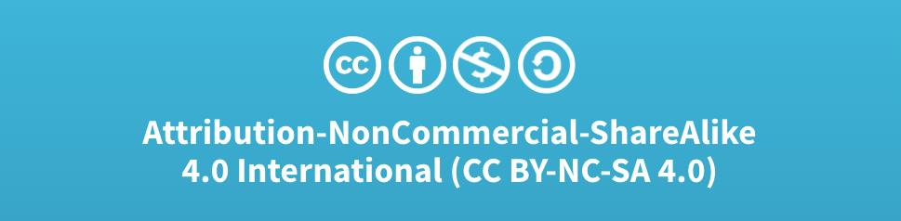
Acknowledgments
Slide Template From:
https://creativecommons.org/licenses/by/4.0/
Slide Content Licensed as:
Creative Commons Attribution-NonCommercial-ShareAlike 4.0 International License.
Notes:
Note: Individual images may be covered by their own licensing agreements and were incorporated here under fair use. Their use in this slide deck does not change or alter their licensing.

